Slide 1
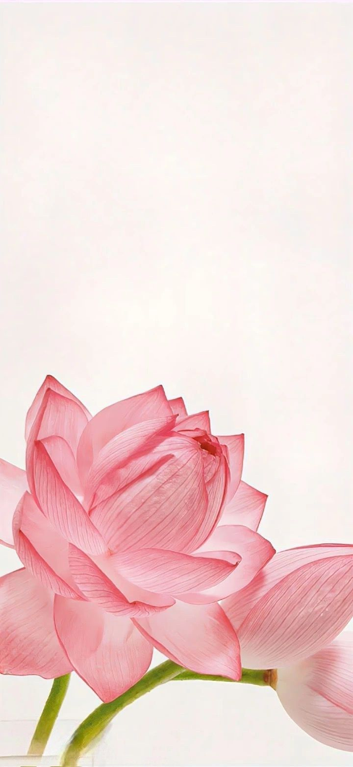
DIGITAL PORTFOLIO
NAME : AMRITA DEVI
REG NO& NMID: 222407883 & autunm1455ds242723
DEPARTMENT : B.SC (CS WITH DS)
COLLEGE : TAGORE COLLEGE OF ARTS AND SCIENCE

Slide 2
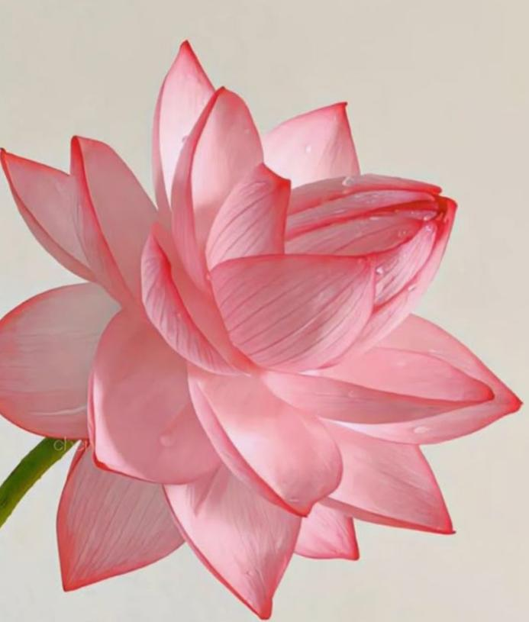
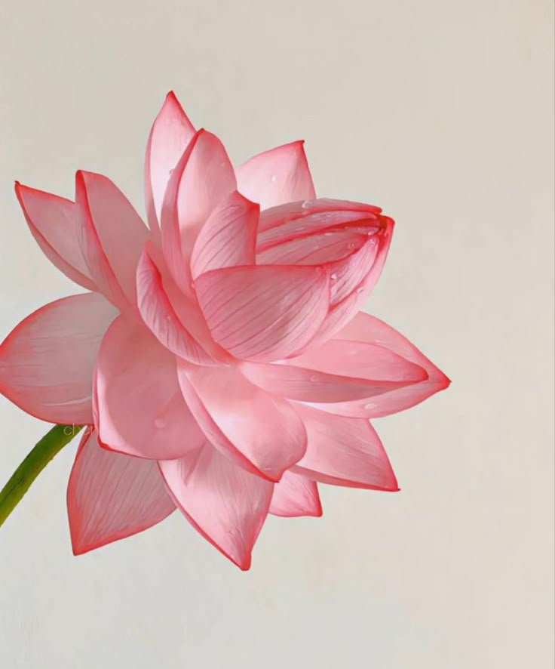
🌸Lotus flower Interiors Design – Digital Portfolio 🌸
Key Points:
• Interior Design
• Space Planning
• 3D visualisation
• Room Makeovers
• Pastel Aesthetic Concepts

Slide 3
AGENDA 🌷
Problem Statement
Project Overview
End Users
Tools and Technologies
Portfolio Design & Layout
Feature and Functionality
Results & Screenshots
Conclusion
GitHub Link 🌷

Slide 4
Problem Statement
Many people desire interiors that feels calm, aesthetic, and timeless, but they struggle to find a single platform showcasing design inspirations and services.
A digital portfolio can solve this by:
Presenting creative designs in one place
Offering easy-to-navigate layouts
Inspiring users with images, styles, and ideas

Slide 5
Project Overview
This project is a digital portfolio for Lotus Flowers Interiors, a concept interior design studio inspired by the elegance of the lotus.
The portfolio highlights:
Services: Styling, planning, visualisation
Aesthetic: Pastel, serene, and floral.
Goal: Inspire clients and showcase unique design philosophy. 🪐

Slide 6
End Users
Homeowner:
To explore makeover ideas
Students:
As a project or portfolio reference.
Interior design:
To learn design styles.
Small Business:
To find creative decor inspiration.

Slide 7
Tools and Technologies
Frontend: HTML, CSS
Images: Free high-quality images from
Unsplash
Editor: Codepen
Hosting: GitHub pages

Slide 8
Portfolio Design & Layout
•Responsive design using HTML+ CSS.
• Home page —> Introduction to lotus and interiors.
• Sections: Services, Portfolio Gallery, About Us, Contact.
• Grid based structure with pastel theme.

Slide 9
Features and functionality
Services showcase
with icons and text.
Portfolio grid with aesthetic images.
Simple navigation: Home| Services| Portfolio| Contact.
Mobile-friendly responsive layout.

Slide 10
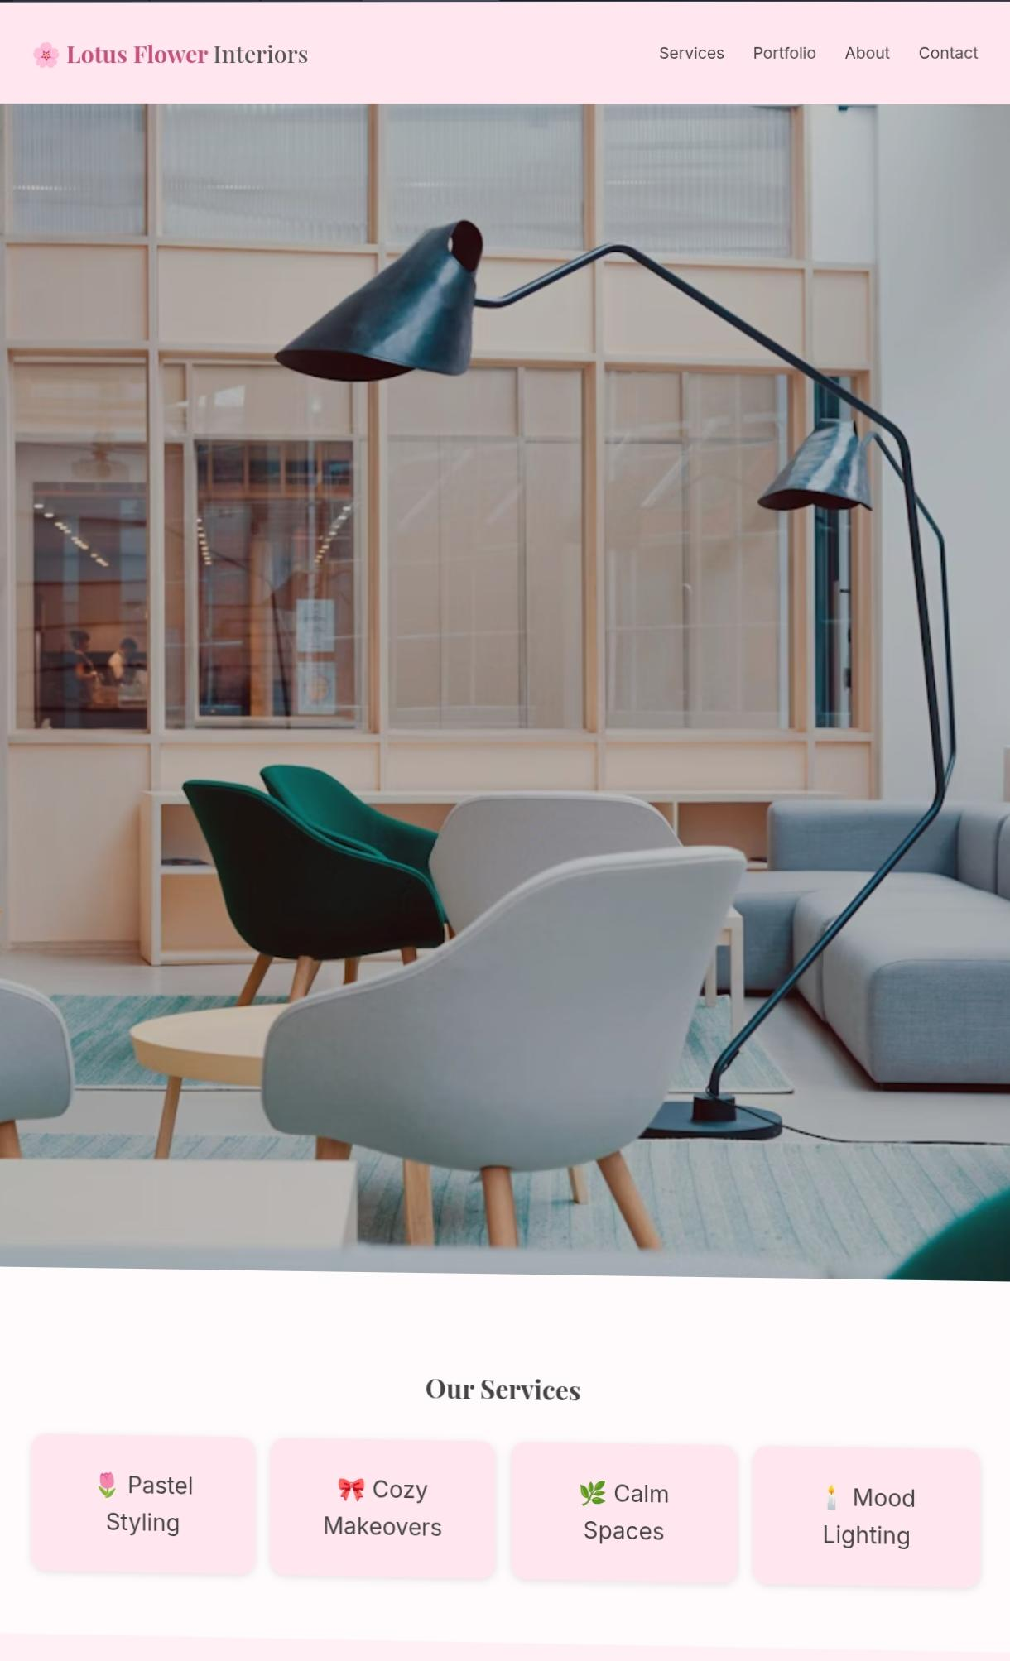
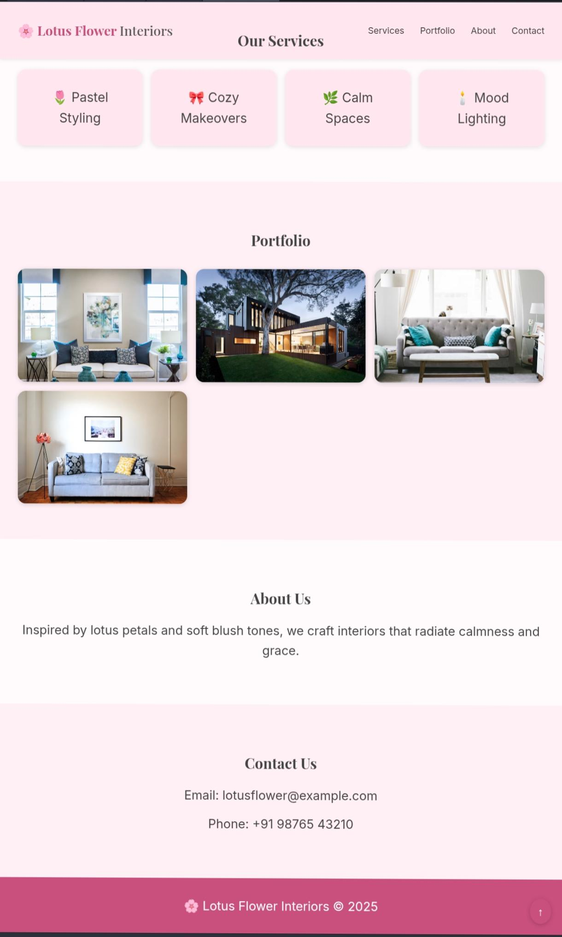
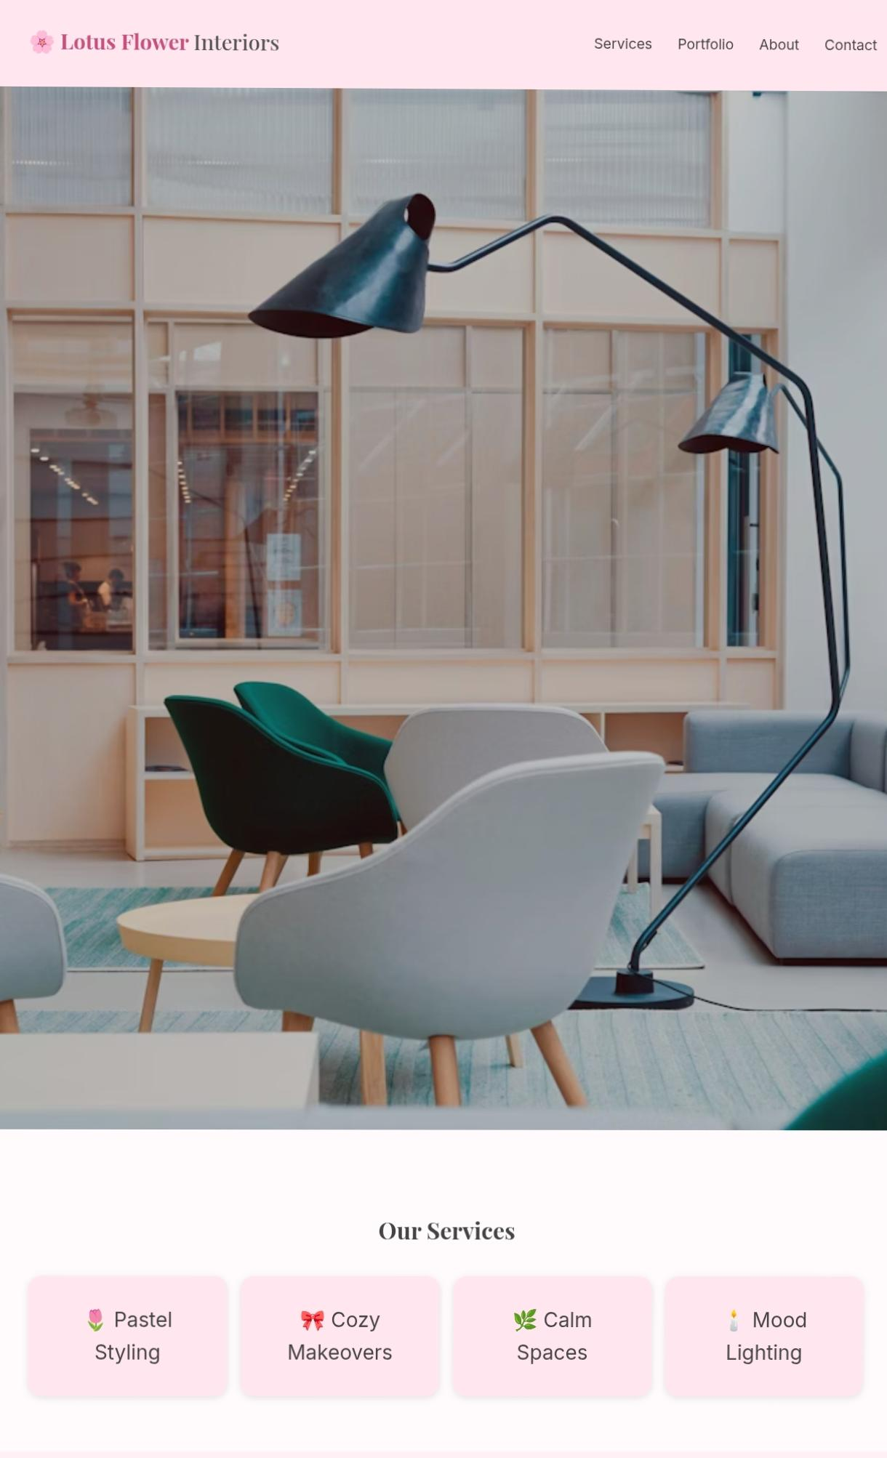
Results and Screenshots

Slide 11
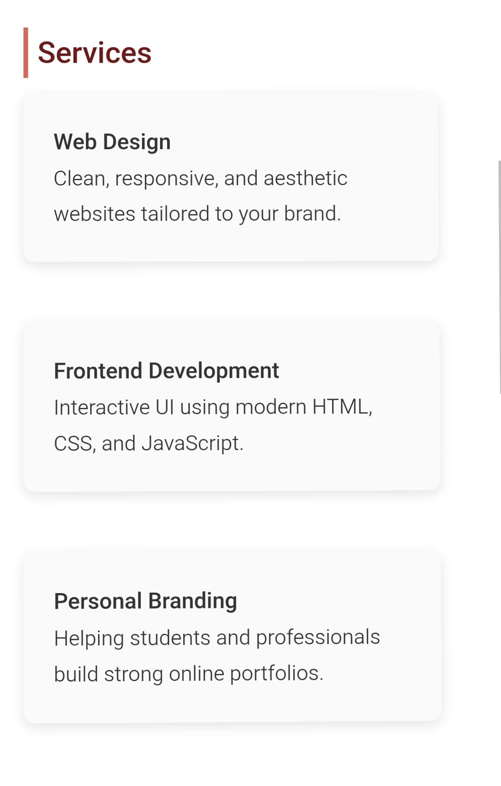
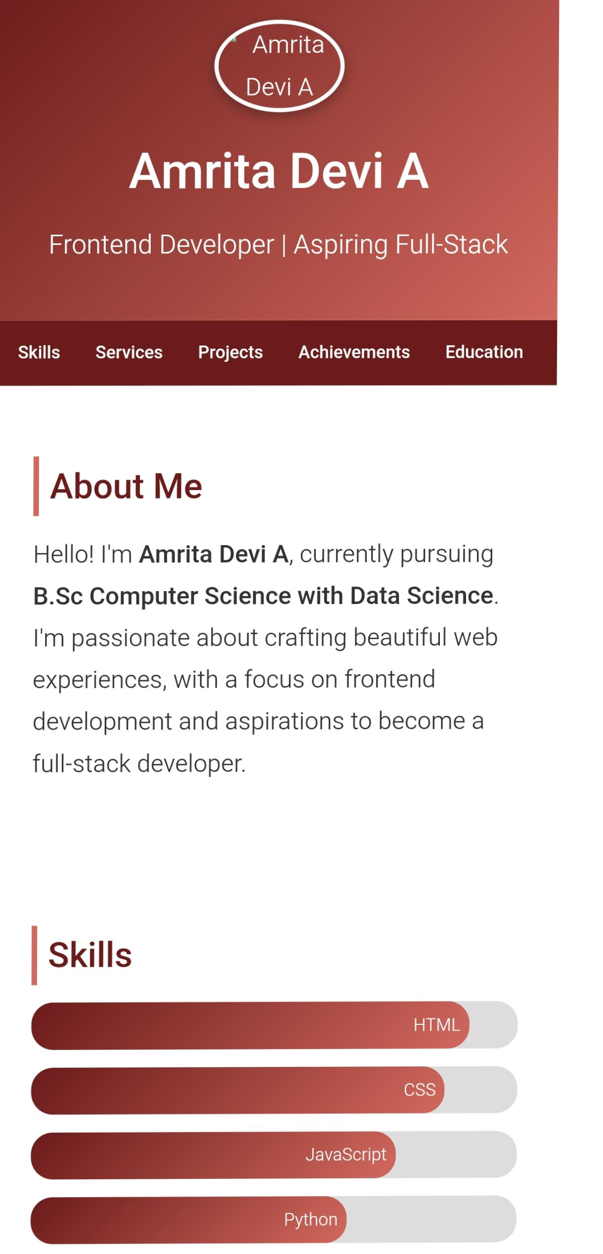
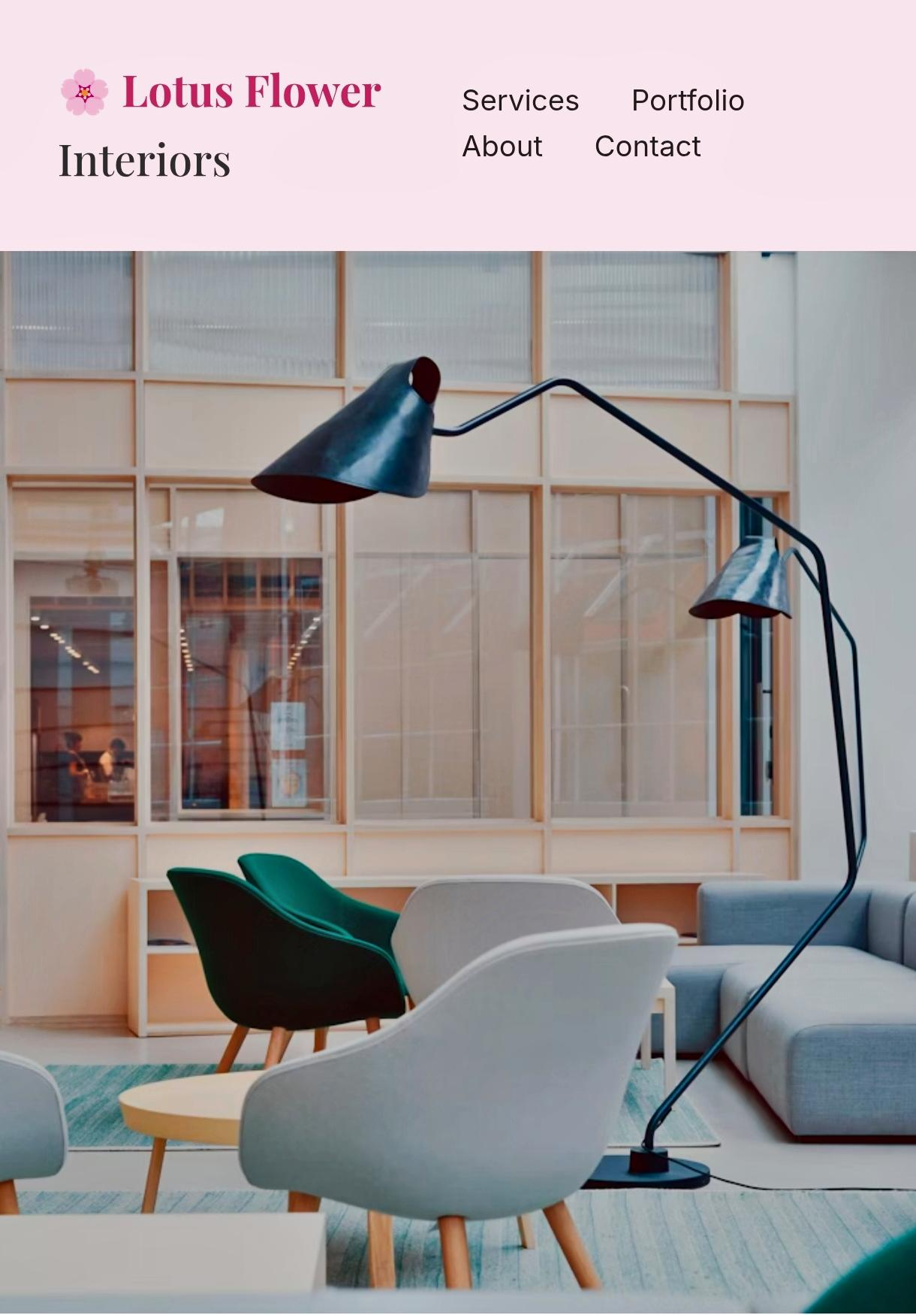
Results & Screenshots

Slide 12
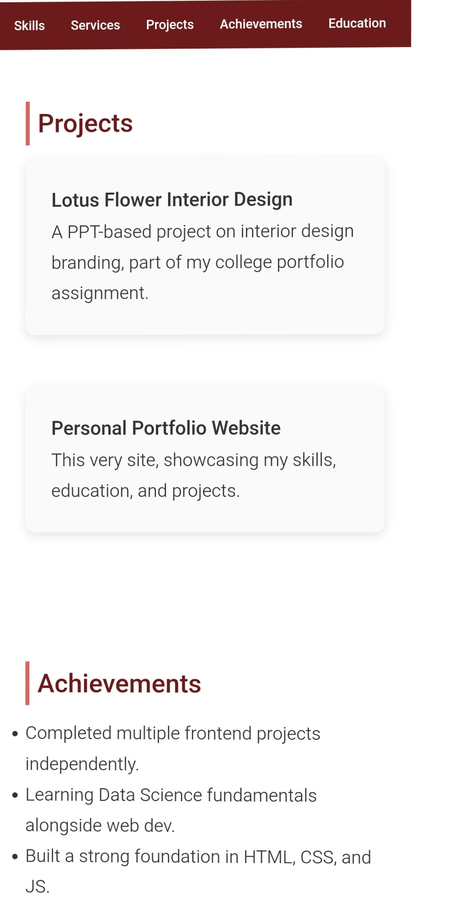
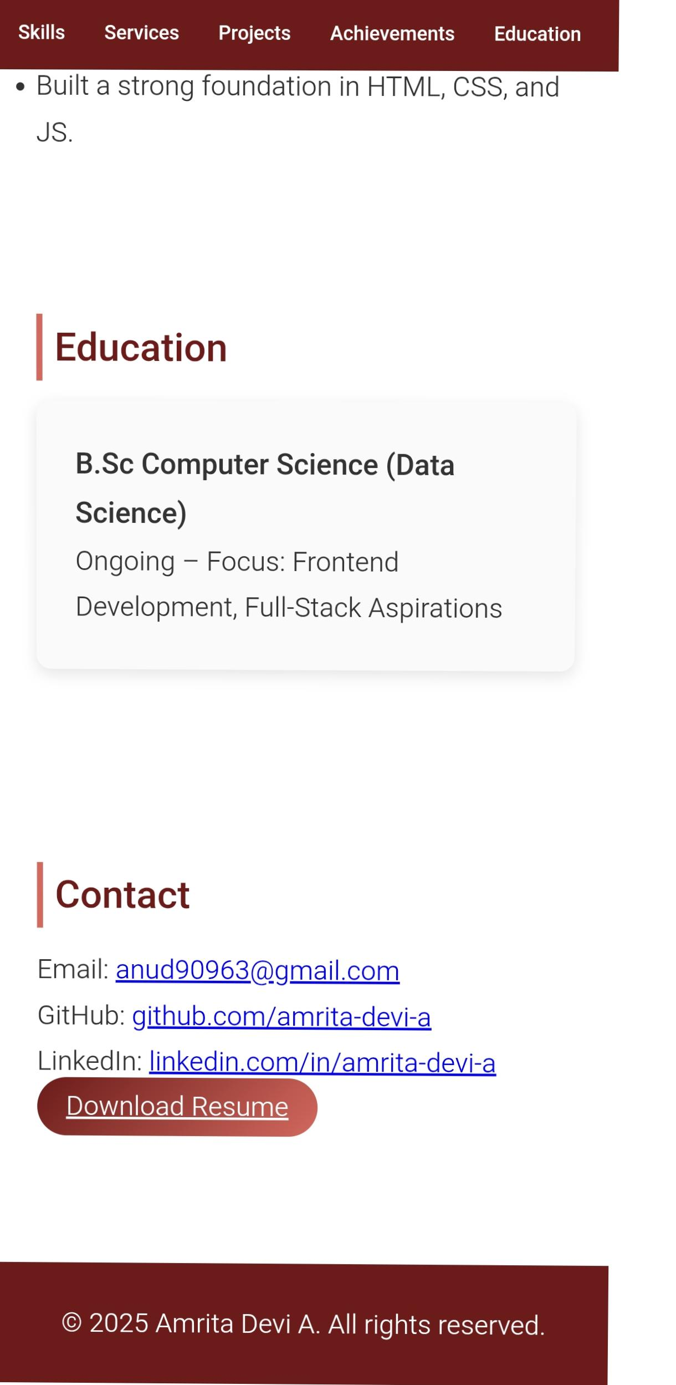
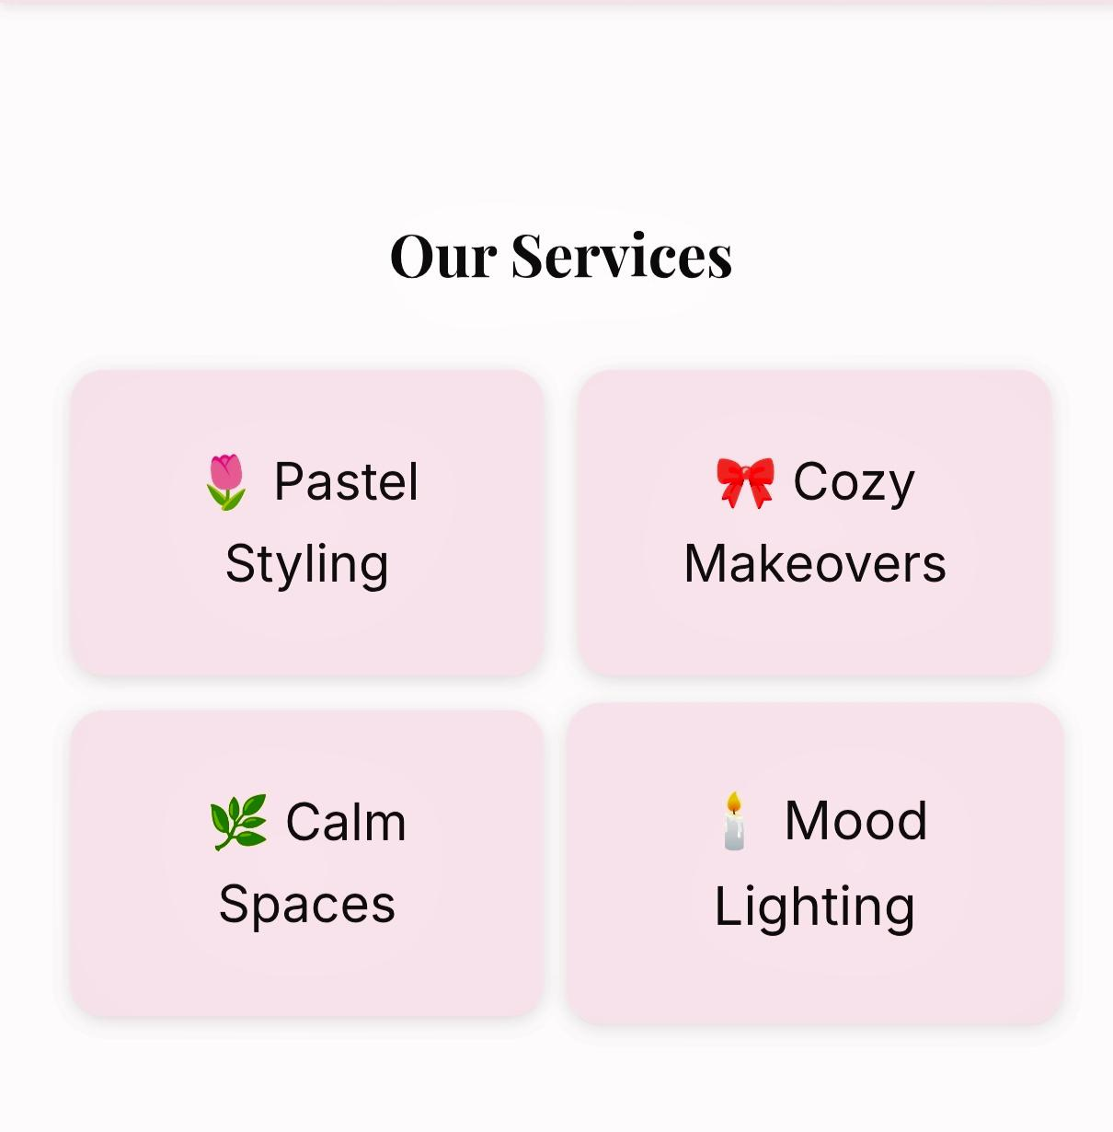

Slide 13
Conclusion
The project demonstrates a professional digital portfolio for Lotus flower Interiors.🌺
° Simple and elegant structure.
° Soft pastel aesthetic.
° Showcase design inspiration & services
° Can be extended into a real business website.
🌺🌺🌺. 🌺🌺🌺

Slide 14
GitHub Link
Amritadevi2006.github.io/Portfolio---Amrita-Devi.-A/
Thank you 🌺🌺

